Slide 1

ONLINE OXYGEN MANEGEMENT SYSTEM
Supervisor:
Assistant Professor Jayati Routh
Presented by
Soumyadeep Das Jaydeep Sarkar Enakshi Pal
SILIGURI INSTITUTE OF TECHNOLOGY
2021 - 2022

Slide 2



CONTENTS
OBJECTIVE
METHODOLOGY
CONCLUSION

Slide 3
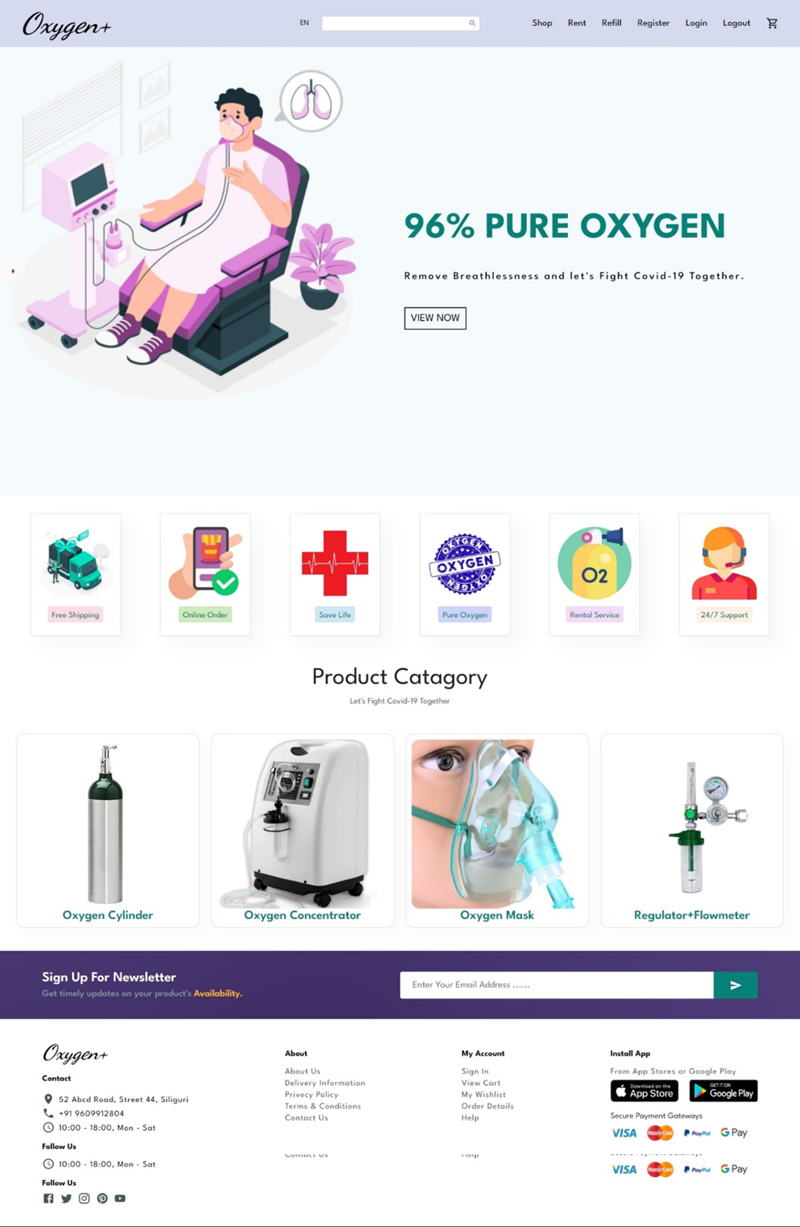
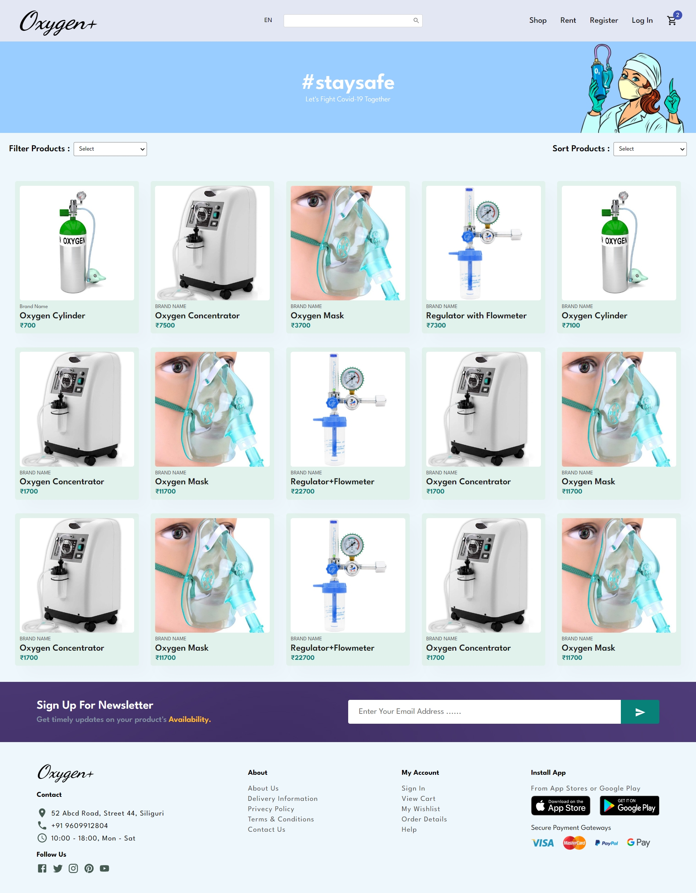
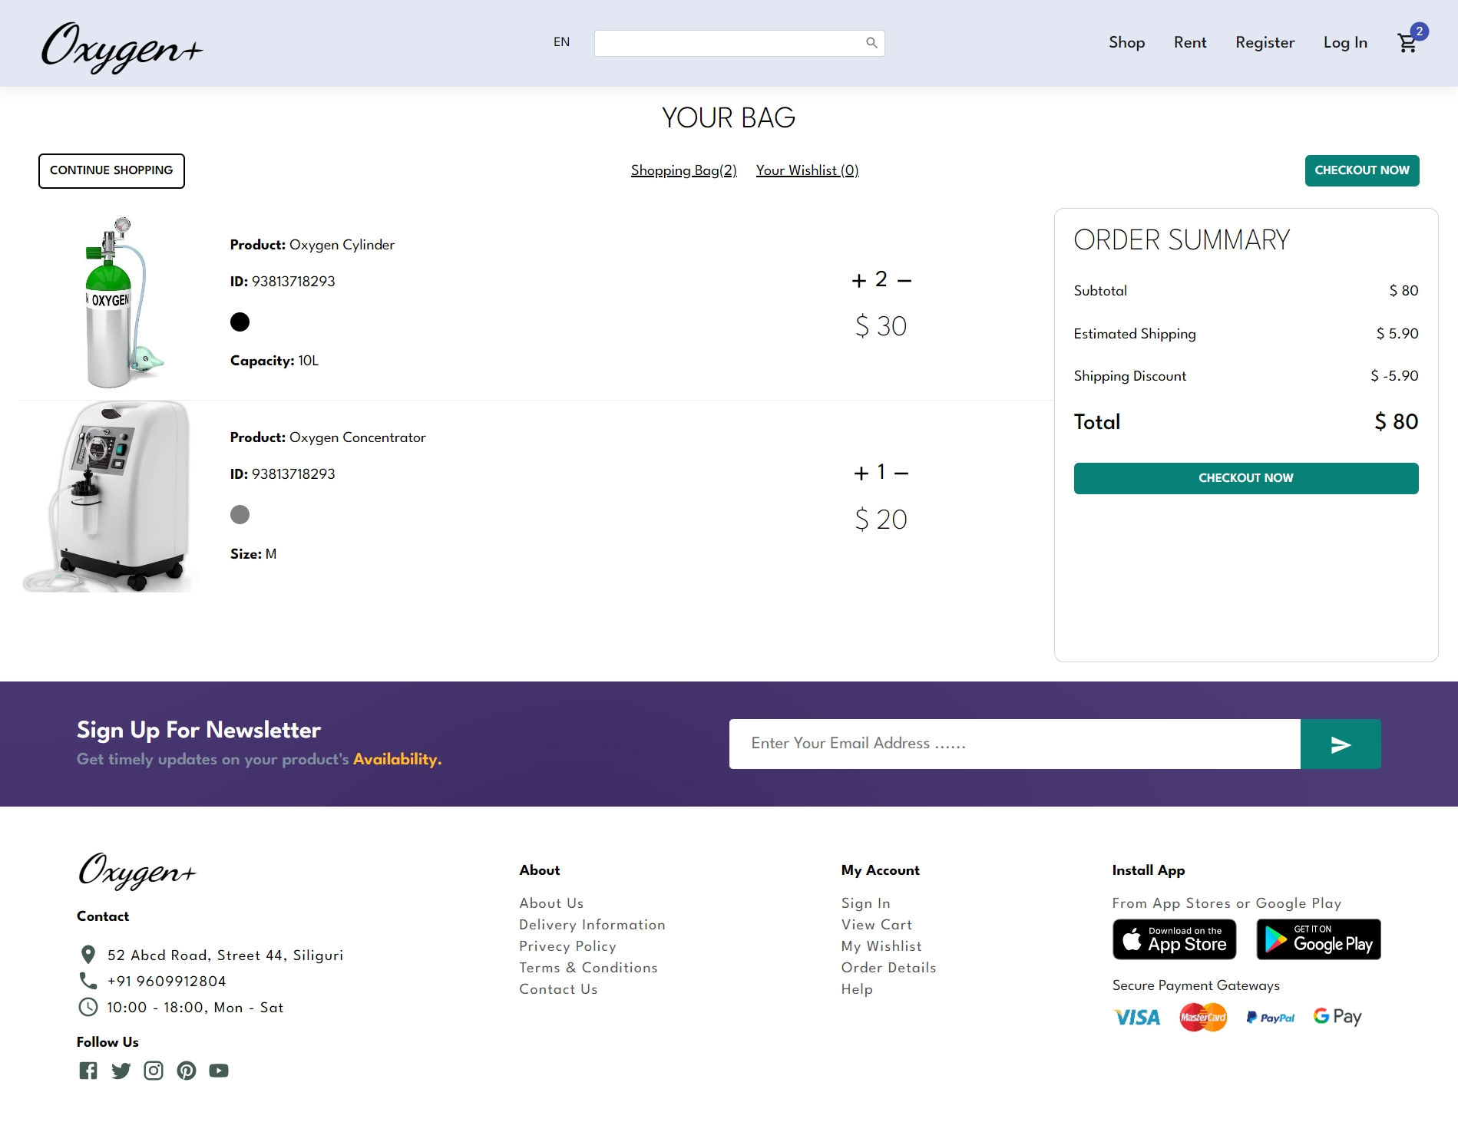
What is Online Oxygen Management System
It’s a digital platform to fast-pace the supply of Oxygen cylinder and other medical supply to both people and hospitals.

Slide 4
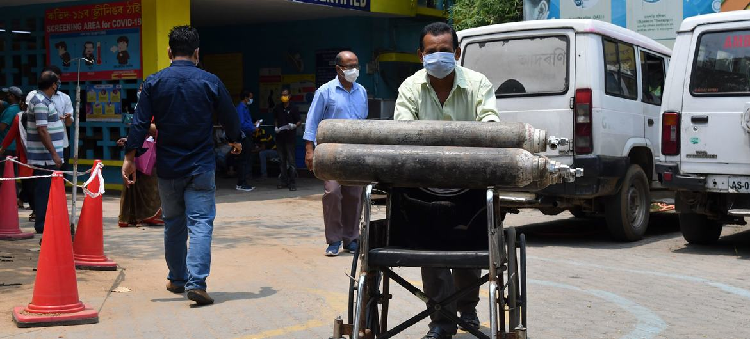
OBJECTIVE
To design an Online Oxygen Management System.
To provide a solution to reduce and optimize the expenses and rush of the patients through proper
availability tracking of the oxygen products.
To create an avenue where people can order for oxygen products online.
To develop a database to store information on the oxygen products and services.

Slide 5


OBJECTIVE
Challenges in building Online Oxygen Management System
Customer Retention
Data Management System
Customer-centric eCommerce challenges can be attributed to many factors such as the evolving expectation of the consumer, the failure to create a pleasant experience, by creating interactive UI.
Data management challenges can affect a host of concerns. Poor risk management decisions, data loss, data breaches, illegal access, data silos, noncompliance with legislation, an unregulated environment, limited number of resources, and so on are examples of these.

Slide 6

Solution
To propose a system which can provide smooth and easy access of oxygen cylinder through few clicks
2. We have created an approach to segment users supply based on the product availability

Slide 7


PROPOSED SYSTEM
Outline of proposed system
The web link will directly connect the needy with officials/workers who are in charge of the oxygen supply chain in the state. All the details will be regularly updated on the portal by the company’s representatives. By tracking availability online, to avoid emergencies, save time and fulfill oxygen demands.
Our platform will help rental services and refilling station of oxygen cylinders with google map location and will help provide oxygen to the hospitals in the shortest possible time as per the demand and requirement.
The proposed system will be assigned to ensure an easy supply of oxygen to local citizens and private hospitals round the clock.

Slide 8
Process Flow Diagram
Start
Admin
Stock Available
Login
User
connect to supplier
Yes / No
Shop
Rent
Payment
Update stock Status
available product
Refill
Add product
Update address
Available supplier
Connect to supplier

Slide 9
METHODOLOGY
Login - User/Admin
If the user logs in, then he/she can opt for shop, rent and refill options.
3. User can shop - Add products to cart, update the address and make payment to the supplier
4. User can rent - Track availability of the products and connect to the suppliers.
5. User can refill - If supplier is available, then the user can connect to the supplier.
6. If the Admin logs in, then he/she can update the availability of the products in the dashboard and add the products accordingly.

Slide 10
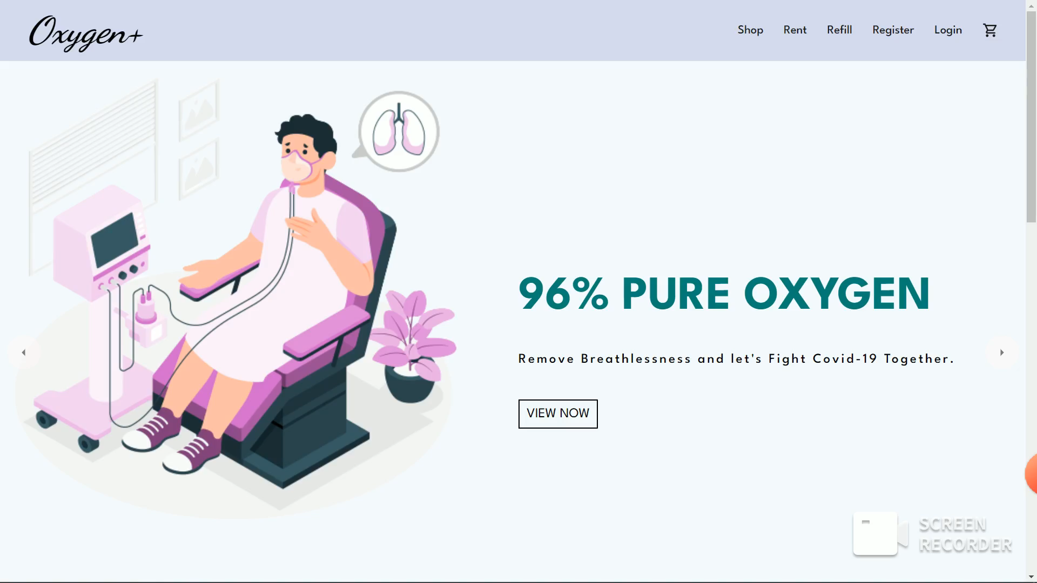

Slide 11

Future Scope
1. Looking forward to enable "Return Empty Cylinder" option, so that the user can return the empty oxygen cylinder after using the oxygen in it in order to reuse the cylinder by refilling the oxygen gas.
2. We are looking forward to expand our system in different other locations as well

Slide 12
THANK YOU

